Slide 1

CONFIDENTIAL

Slide 2


44% of Adults have
Anxiety Disorders
People Shut Down, Can’t Work, Relationships Degrade
“Great Rewiring of Childhood” (Haidt)
Up from 22% in 2003
CONFIDENTIAL
Notes:
Graph or pie chart image
Stock image of a depressed/stressed guy

Slide 3


The Cost of
Anxiety at Work
$1T+
12B
63%
Economic hit
annually
Working days
lost per year
Employees report
burnout
CONFIDENTIAL

Slide 4

Meditation Reduces Symptoms
by 30%
Just as Effective as Anxiety Medication
Reduces Cortisol Levels
CONFIDENTIAL

Slide 5

62% Meditation App Users Dropout
Survey of 40 people who tried EchoScape:
      61%: “My mind wanders too much”
      46%: “I need to move”
      41%: “It feels like a chore”
Calmness brings Consistency
CONFIDENTIAL

Slide 6
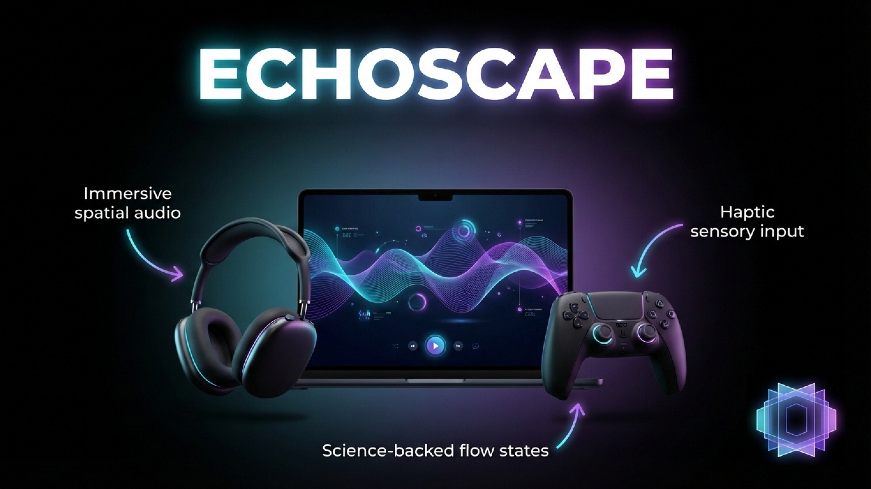
CONFIDENTIAL

Slide 7

Sound Healing
is Neuroscience
Sound Improves Calmness By 65%
Calmness strengthens consistency
CONFIDENTIAL

Slide 8

Game Controller
Drives Calmness
Meditation in Motion Reduces Anxiety Symptoms
Sensory Input Reduces Stress, Increases Concentration
CONFIDENTIAL

Slide 9
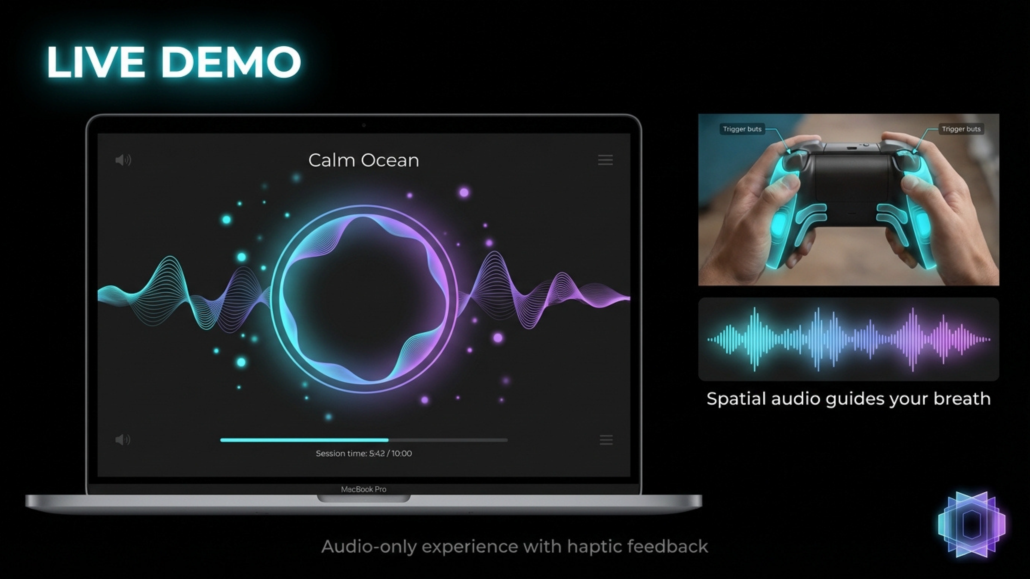
CONFIDENTIAL

Slide 10

97% of EchoScape Users
Felt More Calm
“Calming yet stimulating!”
“Fun and relaxing”
“Unreal. It was very calming and intriguing”
70% felt more relaxed afterwards
CONFIDENTIAL

Slide 11



✓ | ✓ | X | ✓
✓ | X | ✓ | ✓
✓ | X | X | ✓
✓ | ✓ | ✓ | X
✓ | X | X | X
Immersive Sound Library
Controller Input
Multi-sensory
Personalized Journey
Create Your Calm
CONFIDENTIAL

Slide 12
1 Billion Gamers Worldwide Have Anxiety
$28 Billion+:
Digital Mental Health Market
$200 Million:
Meditation App and Gaming
$20 Million:
Age 18-35 Anxious Gamers
CONFIDENTIAL
Notes:
68 Million Gamers Have Anxiety in the US alone. There are roughly 205 million gamers in the US alone
There are 3.2 billion gamers worldwide. When you take into account the average of 30% of the population having an anxiety disorder (whether diagnosed or not), you get ~1 billion

Slide 13

Built-in User-base of
147 Million Gamers
Release on PC/Mac via Steam (free platform)
Market via Indie Gaming Press
Scale to iOS/Android
CONFIDENTIAL

Slide 14
Month 1-3
Hire Team
of Engineers
for full production
Month 4-6
Steam
Early Access
User Feeback
Year 1
Analytics
Content Updates
Year 2+3
Scale to
iOS/Android
3-Year Revenue: $5M
CONFIDENTIAL

Slide 15
Funding for Full Development
2 Engineers + 1 Designer
$250,000
Sound Libraries
Partnerships and Press Outreach
CONFIDENTIAL

Slide 16
Team
Mike Ahearn Wilcox
Founder
Greg Donovan
Advisor
Natalia Pollack
Contributor
CONFIDENTIAL

Slide 17

CONFIDENTIAL

Slide 18
Appendix
CONFIDENTIAL

